Slide 1





Final Project
Seung Min Song
Table of contents:
1. Data
2. Exploratory data analysis
3. Inference
4. Conclusion

Slide 2

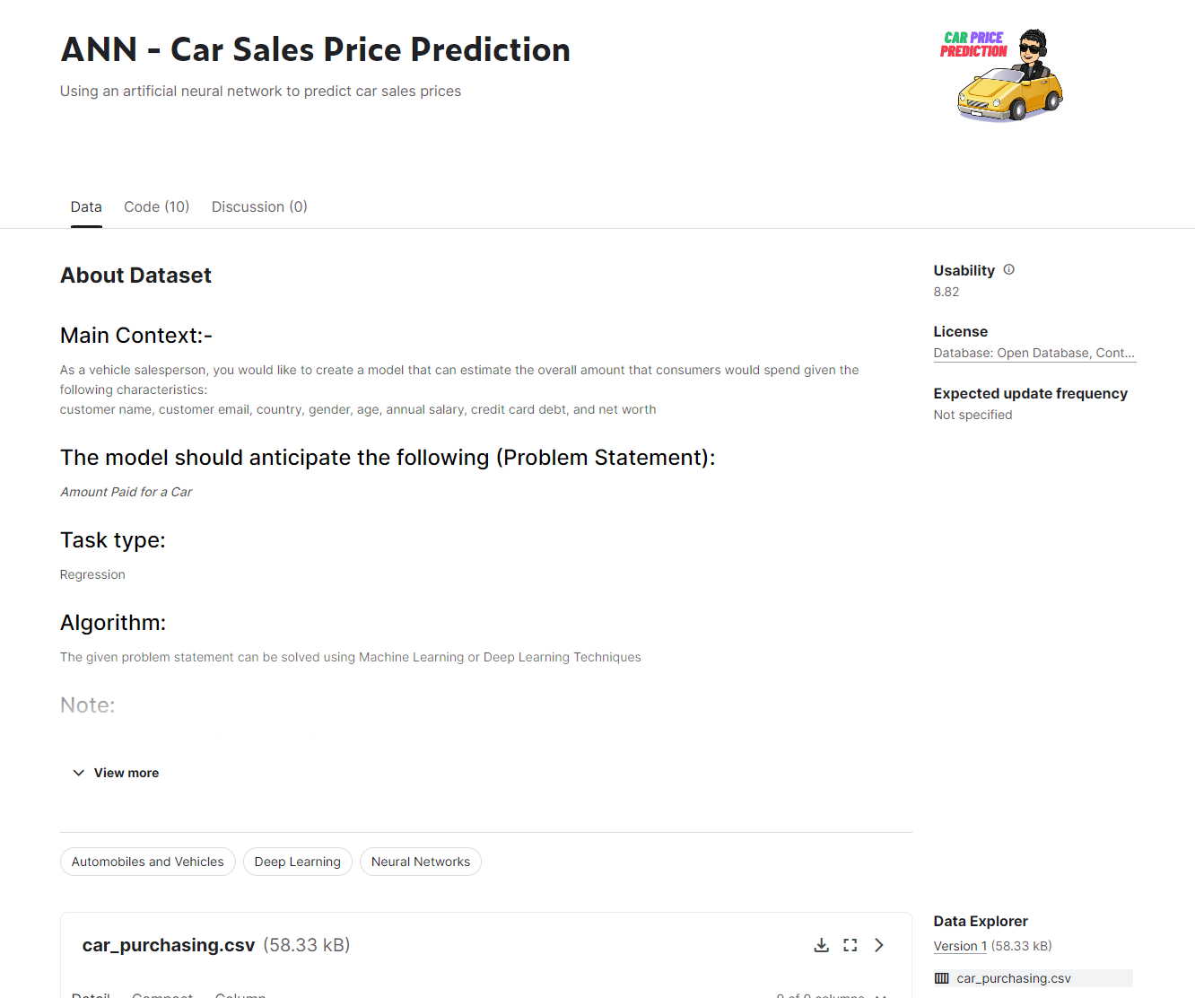

Data
DATA:
I downloaded the csv data table from: https://www.kaggle.com/datasets/yashpaloswal/ann-car-sales-price-prediction
The main objective of this project is to study the relationship and correlation between average salary, net worth, and car purchase amount.

Slide 3
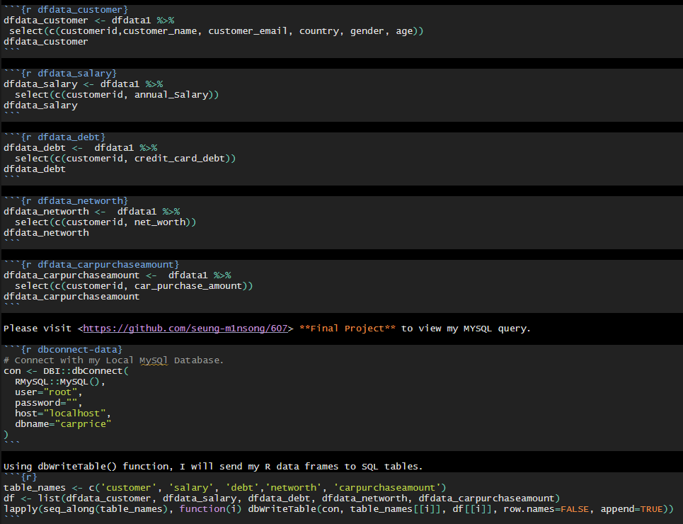
Data
MySQL:
create new column with auto increment named, **customerid**. I will use this **custoemrid** to connect all my sql tables.

Slide 4
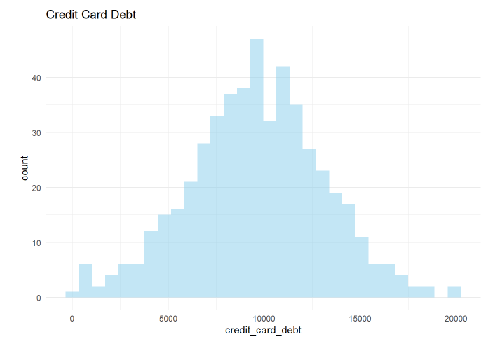
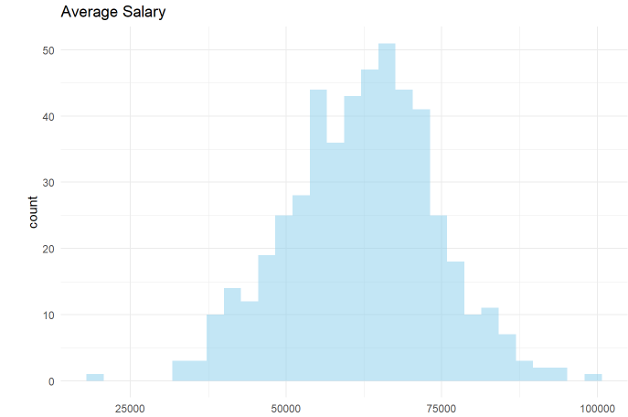
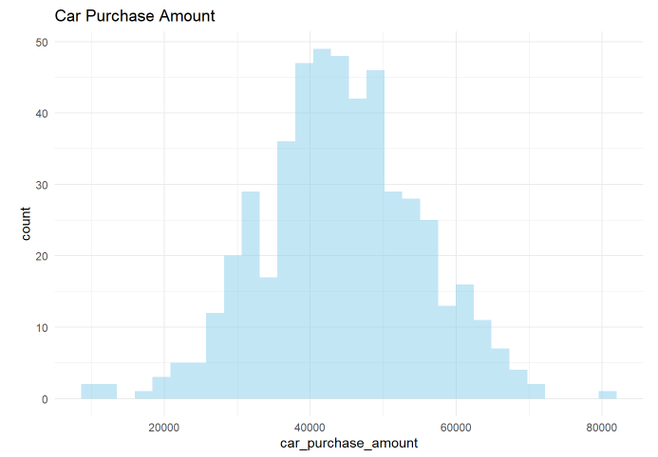
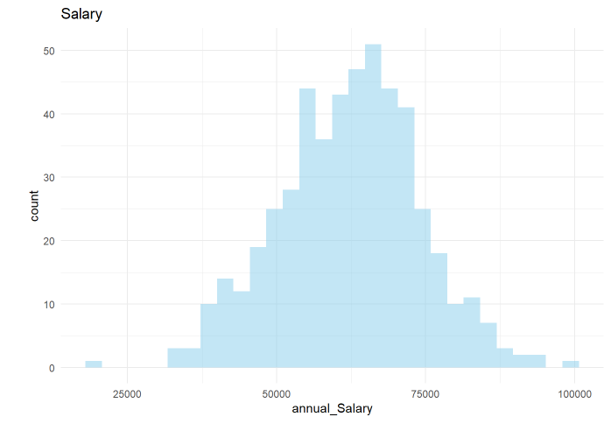
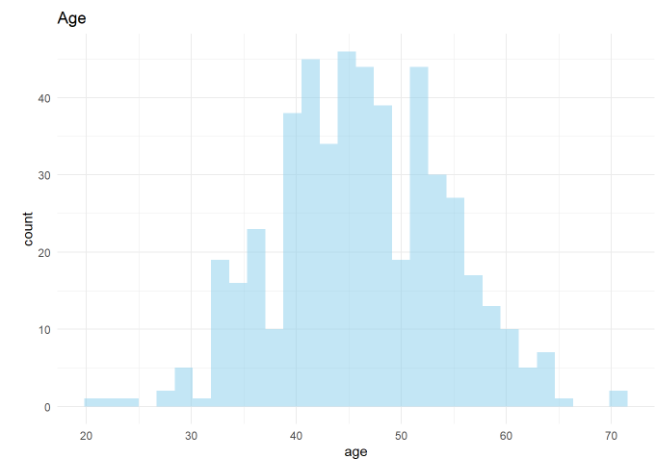
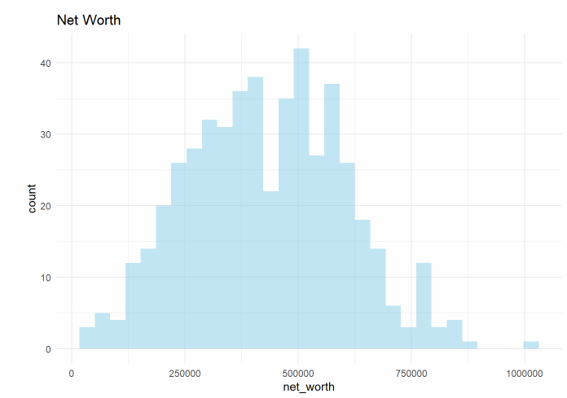
Exploratory Data Analysis
All histograms were normally distributed. Also, outliers exist in all histograms.

Slide 5
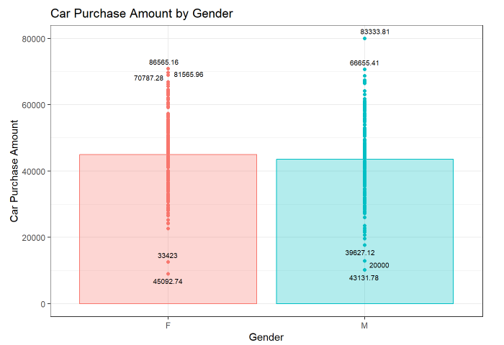
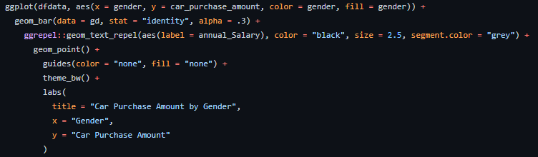
Exploratory Data Analysis
Gender:
We have 253 male and 247 female in this study. Female average price is higher than man. However, man has highest car purchase amount. The boxplots show that the medians and interquartile range of the two distributions are very close.

Slide 6
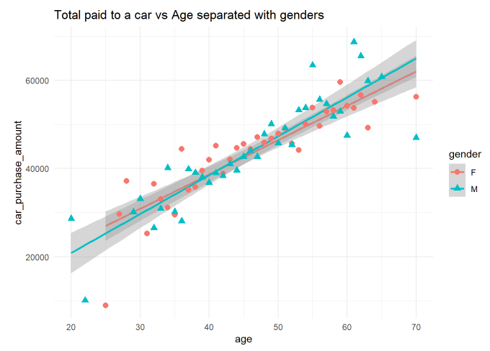

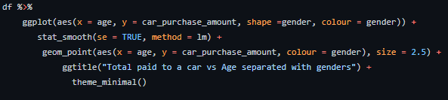

Exploratory Data Analysis
Age:
Total paid to a car vs age separated with genders. Car purchase amount increases when age increases.
Calculating the correlation between **age** and **car_purchase_amount**.
It has a moderate positive relationship

Slide 7
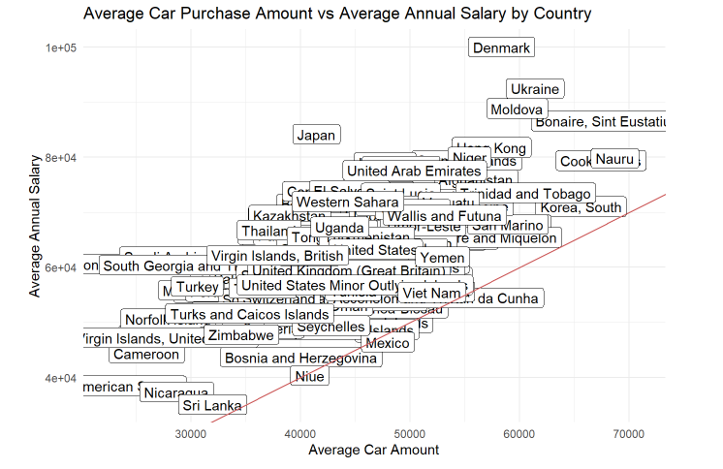
Exploratory Data Analysis
Country:
Use ggplot() + geom_point to compare car_purchase_amount by country. The geom_abline displays the red line in the graph. Any country name above the red line indicates annual salary is higher than the purchased car price and the country name below the red line indicates annual salary is lower than the purchased car price. Most of countries purchased a car below their annual salary.

Slide 8
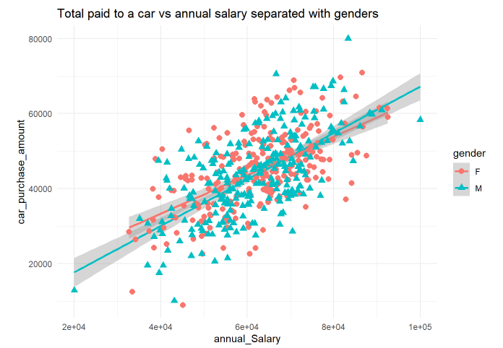

Exploratory Data Analysis
Salary:
Comparatively, women bought more expensive cars than men. Probably because the more expensive the car, the safer it is. Also, as seen here, the higher the annual salary, the higher the car purchase price.
I used ‘Predict’ and ‘lm’ to predict the car price when the salary is $65,000. The result is $45,843.69

Slide 9
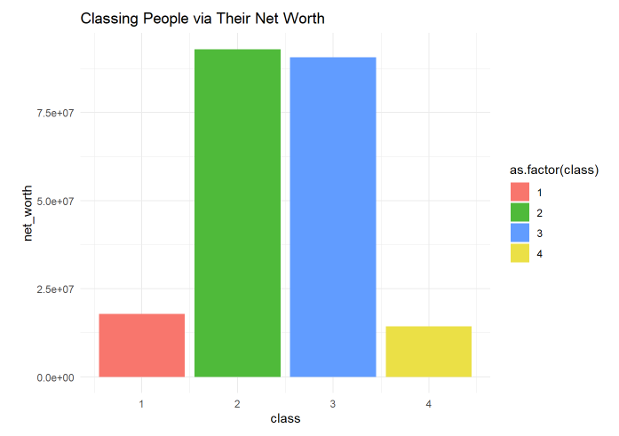
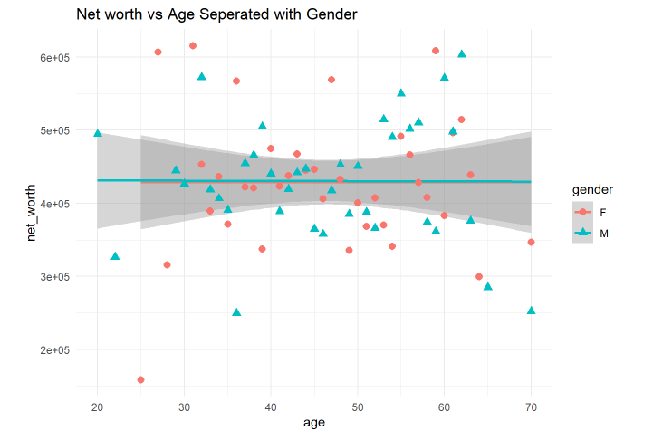


Exploratory Data Analysis
Net Worth:
I used ‘Predict’ and ‘lm’ to predict at with 65,000 annual Salary and 500000 networth the car_purchase_amount will be $47865.01.

Slide 10
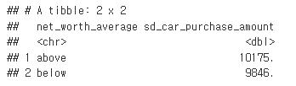
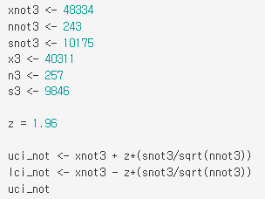
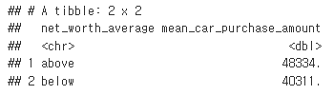

Inference
1. The cases are car purchase amounts and there are 500 cases in the data set.
2. Both sample sizes are bigger than 30, it is a random sample, and observation is independent.
Therefore the conditions for inference should be satisfied.
3. Use mutate to add new column named net_worth_average, values with above and below.
4. With 95% confident that people whose net_worth is above average have an average car_purchase_amount between 47054.66 and 49613.34. Also, people whose net_worth is below average have an average car_purchase_amount between 39107.21 and 41514.79 with a 95% confident level. People with higher net worth spend more money purchasing cars.

